Slide 1
IN609
Operations Engineering 1
PowerShell Modules
Lecture 4-1
Semester 2, 2021

Slide 2
Overview
We Will talk about powershell modules
Powershell modules
Commands to work with modules
Writing a module
Documentation
3

Slide 3
Powershell Modules
Modules are essential for organizing code
Partition, organize and organize code into self contained reusable units
Allows you to control scope of variables
Modules can have number of functions, variables and scripts
Powershell modules have extension .psm1
16

Slide 4
Commands related to modules
Get-installedmodule : find all installed modules on the local computer
find-module –name “Azure*” –repository psgallery : finds all Azure modules from powershell gallery
Install-module: will install module
Import-module: will import module
18

Slide 5
Module Components
Modules can have only a script file with .psm1 extension or can have manifests files that describe the module files and metadata
Dynamic modules are not loaded from or saved to a file.
Created dynamically using new-module
Binary modules are .NET framework assembly (.dll) that contains compiled code
17

Slide 6
Writing module
$env:psmodulepath will show the paths where you should keep your modules
The module directory name should be same as the script (.psm1), manifesto files (.psd1)
Export-moduleMember is used to export functions, variables and aliases from the module
4

Slide 7
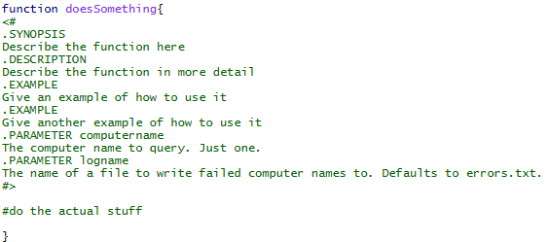
Documentation

Slide 8
Resources
Default Reference for PowerShell:
https://technet.microsoft.com/en- us/library/hh847741.aspx
Specific information about core modules
https://technet.microsoft.com/library/hh849695. aspx
Good blog for specific PowerShell tips
http://blogs.technet.com/b/heyscriptingguy/
21

